Slide 1
JUnit & Cucumber-JVM

Slide 2
Pre-requisites:
Java 11
IntelliJ IDEA Community 13.x (latest – includes Maven)
Maven dependencies (pom.xml):
junit 4.x (latest)
cucumber-jvm 7.x (latest)

Slide 3

Key features
Provides assertions for testing expected results.
Provides test runners for running tests.
Provides annotations to identify test methods.

Slide 4
JUnit - API
Assert class - provides a set of assertion methods useful for writing tests
void assertEquals(Object expected, Object actual) - asserts that two objects are equal.
void assertTrue(boolean condition) - asserts that a condition is true.
void assertFalse(boolean condition) - asserts that a condition is false.
void assertNotNull(Object object) - asserts that an object isn't null.
void assertNull(Object object) - asserts that an object is null.
void fail() - fails a test with no message.

Slide 5
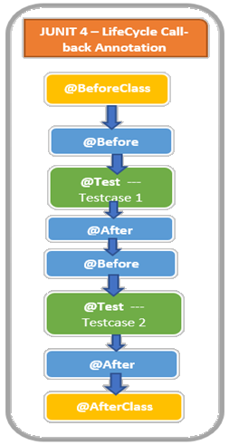
JUnit - API
Annotation Types:
@Before - method is executed before each test.
@BeforeClass - method is executed once before each test class.
@After - method is executed after each test.
@AfterClass - method is executed once after each test class.
@Test - identifies a method as a test method.
@Ignore - method will be ignored when running the test suite

Slide 6
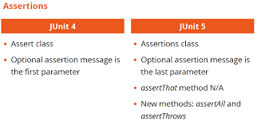
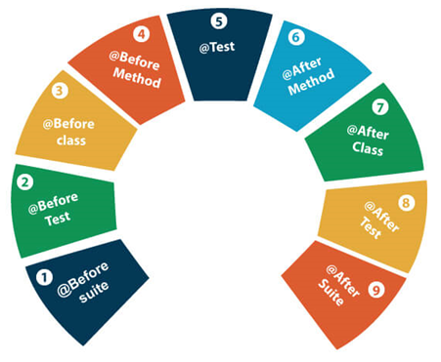

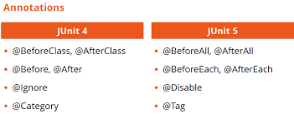
Junit - Alternatives

Slide 7


Slide 8

Cucumber-JVM
Key features
Based on Gherkin syntax
Helps employing Behavior-Driven Development (BDD)
Supports many programming languages
Acts as a bridge between the business and technical language
Allows the involvement of non-programmers as well

Slide 9
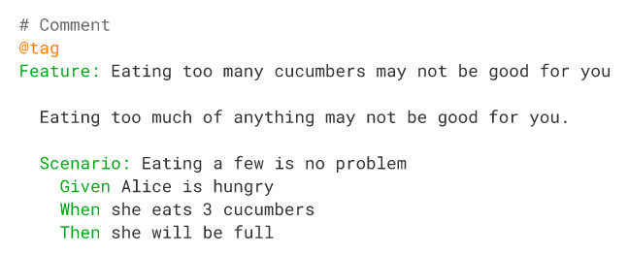
Cucumber - example

Slide 10
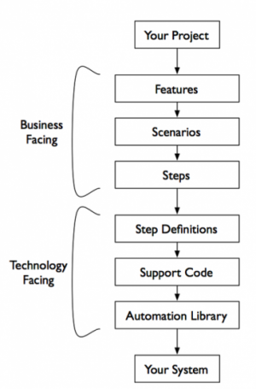
Feature file keywords:
Feature - describes the application feature under test
Scenario - describes the test case details
Given - describes the preconditions and initial state before the start of a test and allows for any pre-test setup that may occur
When - describes actions taken by a user during a test
Then - describes the outcome resulting from actions taken in the When clause
And - is logical “and”

Slide 11
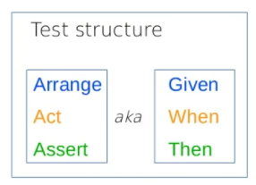
Cucumber – other key features
Given steps - are used to describe the initial context of the system
When steps - are used to describe an event or an action
Then steps - are used to describe an expected outcome or result
But steps - are logically the same as And steps, but used in the negative form
Gherkin - supports using an asterisk (*) in place of any of the normal step keywords
Scenario Outline - used to run the same Scenario multiple times with different combinations of values
Background - setup before each scenario runs (like @BeforeMethod from JUnit).
Tags - used to organize your features and scenarios. E.g.: @SmokeTest
Glue - defines the location where the steps are defined
Comments - use “#” in the feature file

Slide 12
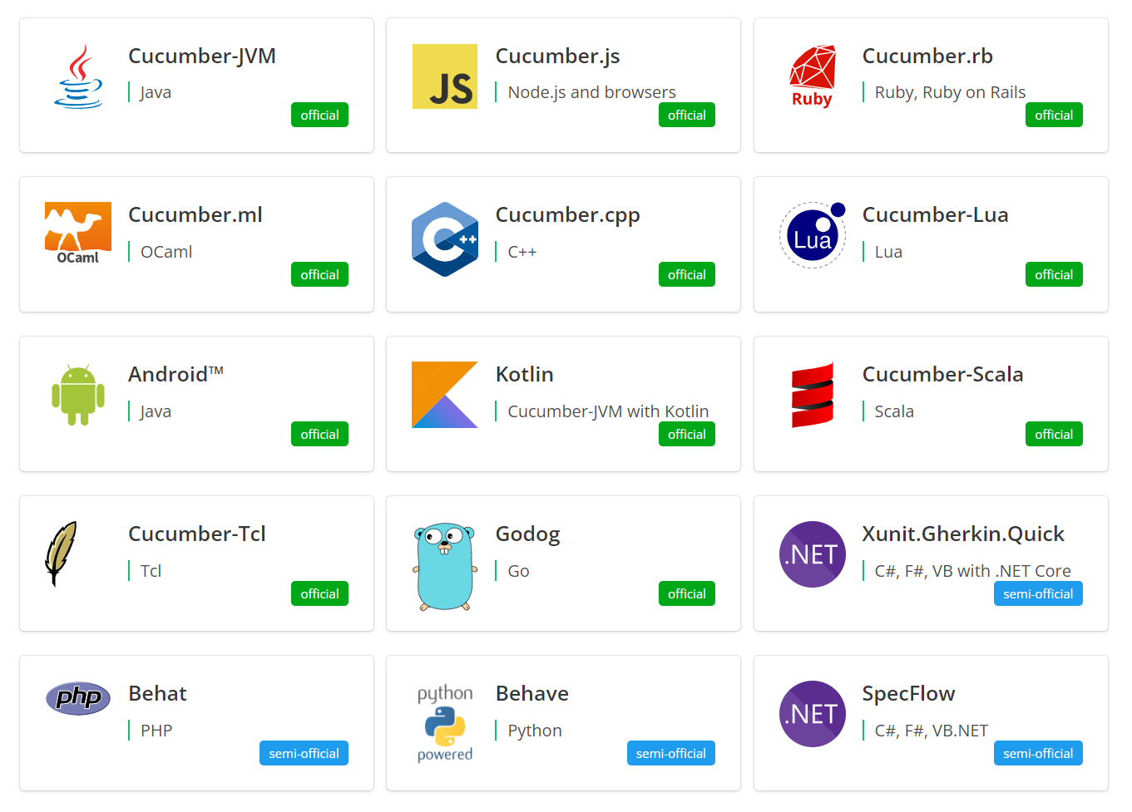
Cucumber - alternatives

Slide 14
Useful links
JUnit
http://junit.org/junit4/javadoc/latest/index.html?overview-summary.html
https://examples.javacodegeeks.com/core-java/junit/junit-best-practices/
Cucumber
https://cucumber.io/docs/installation/
https://cucumber.io/docs/guides/10-minute-tutorial/
https://saucelabs.com/blog/write-great-cucumber-tests

